Slide 1
Fonds R. Vermeersch - J. Latin (265147)
June 16 2009 at 4:06:04

Slide 2
Collection Sociétés Coopératives (526805)
February 18 2011 at 1:02:22

Slide 3
Collection Coopératrices (1013046)
September 22 2011 at 12:09:45

Slide 4
Collection Disquettes (1900705)
August 30 2012 at 7:08:42

Slide 5
Collection Diapositives (1900706)
August 30 2012 at 7:08:18

Slide 6
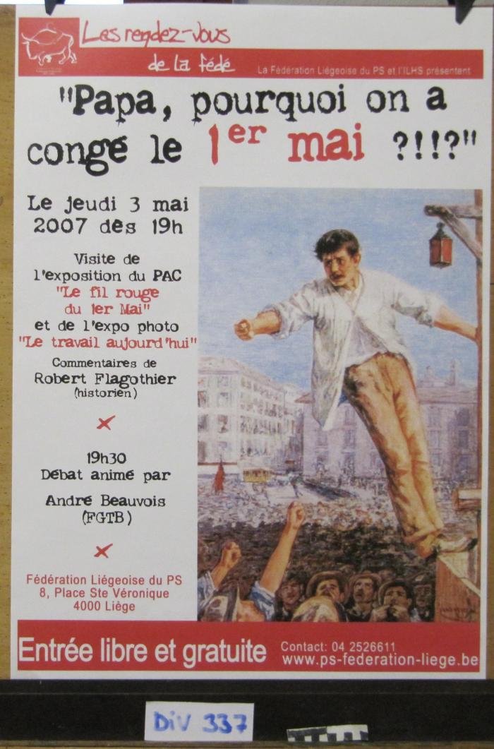
Papa, pourquoi on a congé le 1er mai ?!!? (ARC-C AFF DIV 0337)

Slide 7
Cartes de voeux et invitations 2016 (ARC-C CAR 2016)
July 17 2014 at 4:07:42

