Slide 1
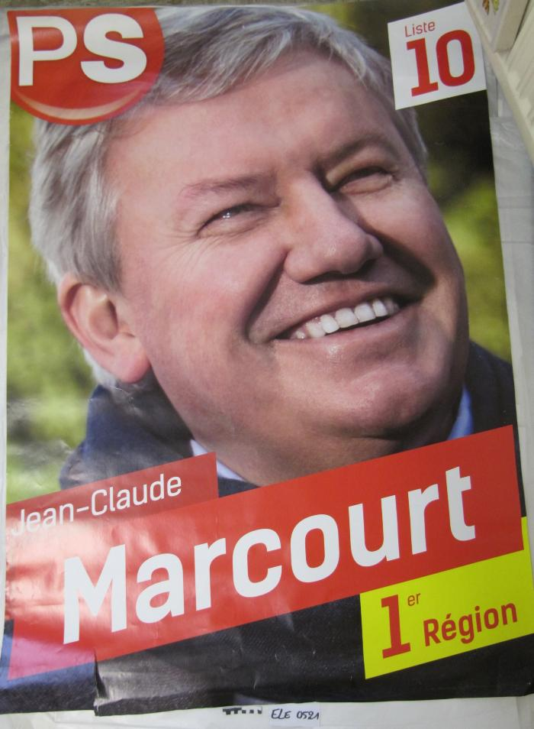
Jean-Claude Marcourt : 1er Région (ARC-C AFF ELE 0521)

Slide 2
Cartes de voeux et invitations 2017 (ARC-C CAR 2017)
July 17 2014 at 4:07:42

Slide 3
Cartes de voeux et invitations 2016 (ARC-C CAR 2016)
July 17 2014 at 4:07:42

